Slide 1


Distributionally Robust Fair Principal Components via Geodesic Descents
Hieu Vu, Toan Tran, Man-Chung Yue, Viet-Anh Nguyen

Slide 2
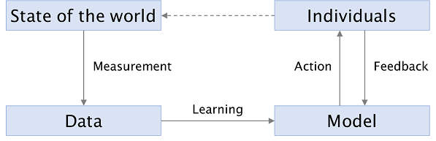
Unfairness problem and PCA
Unfairness can appear in every step of a machine learning pipeline
Data preparation
Validation
Visualization
Feature extraction
Model training
Model evaluation
PCA
source

Slide 3
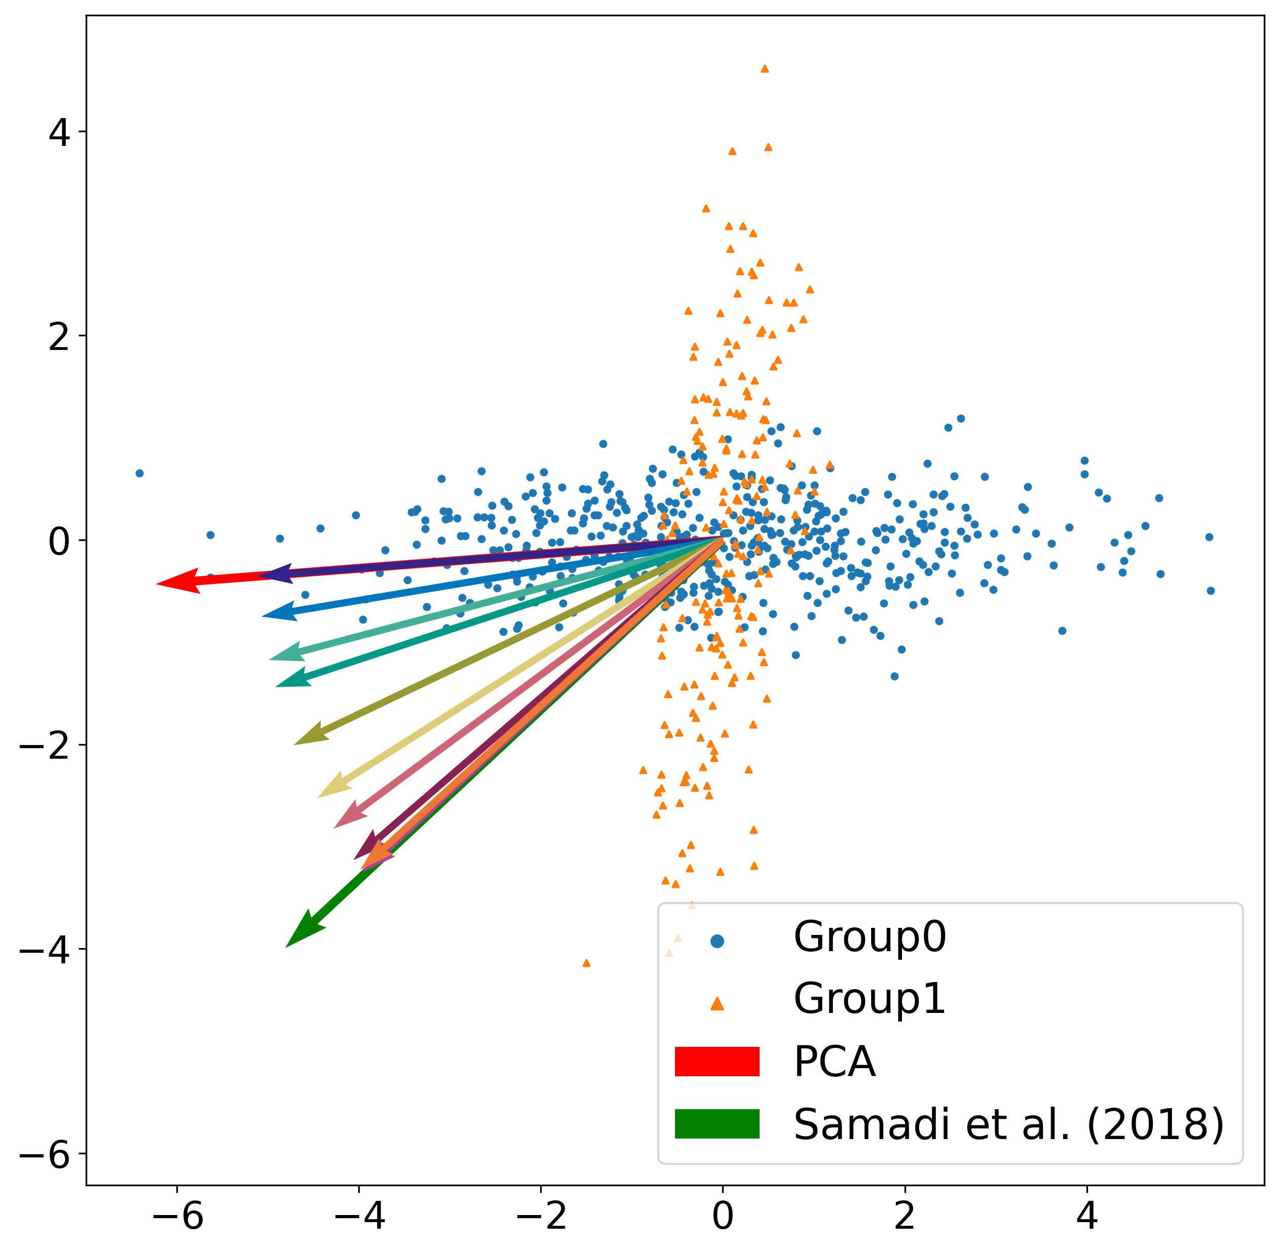
Distributionally Robust Fair PCA
Contributions:
Propose a Fair PCA method which balances the total reconstruction error and the gap of reconstruction error between subgroups.
Incorporate the distributional robustness into a Fair PCA model
Pros:
Exact reformulation, no relaxation
Flexibility in controlling the fairness level
Robust projection against data perturbations

Slide 4
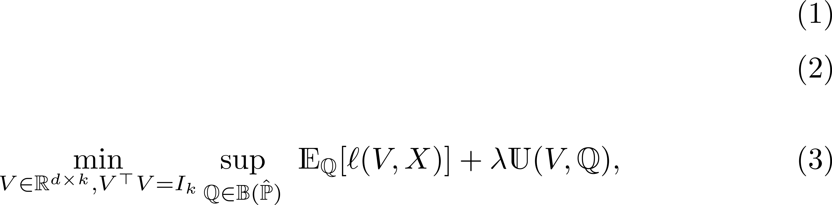
Robust & Fairness-aware Formulation
Fairness penalty
Wasserstein moment-based ambiguity set

Slide 5
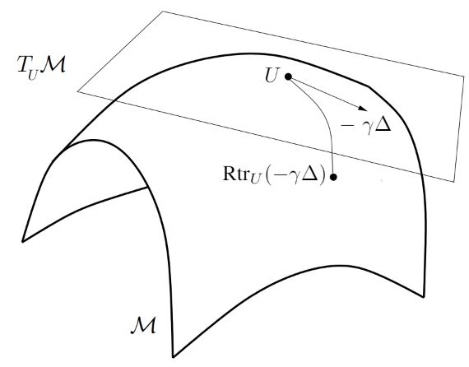
Robust & Fairness-aware Formulation
Reformulate (3) as a finite-dimensional minimax problem over the Stiefel manifold
Reparameterize into a weakly-convex optimization problem
Apply the Riemannian subgradient descent algorithm:
Compute Riemannian subgradient
Get retraction of the updated point
Ensure a sub-linear convergence rate
source

Slide 6
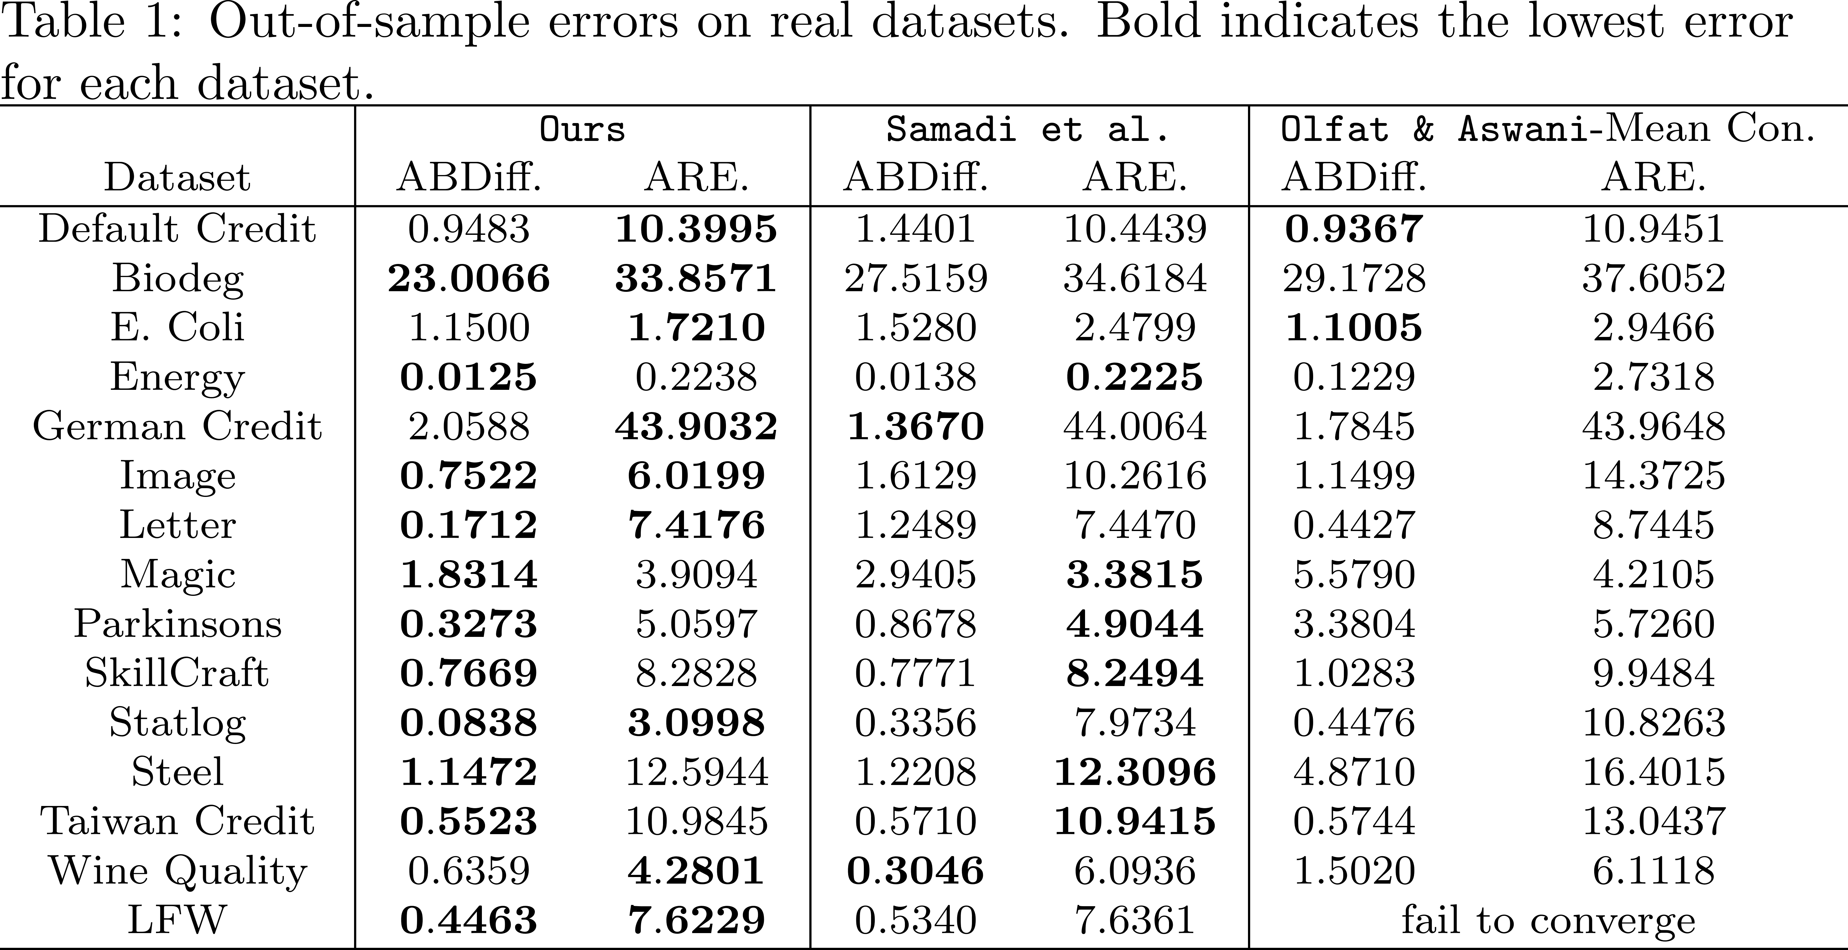
Experiment Results
Criterions:

Slide 7
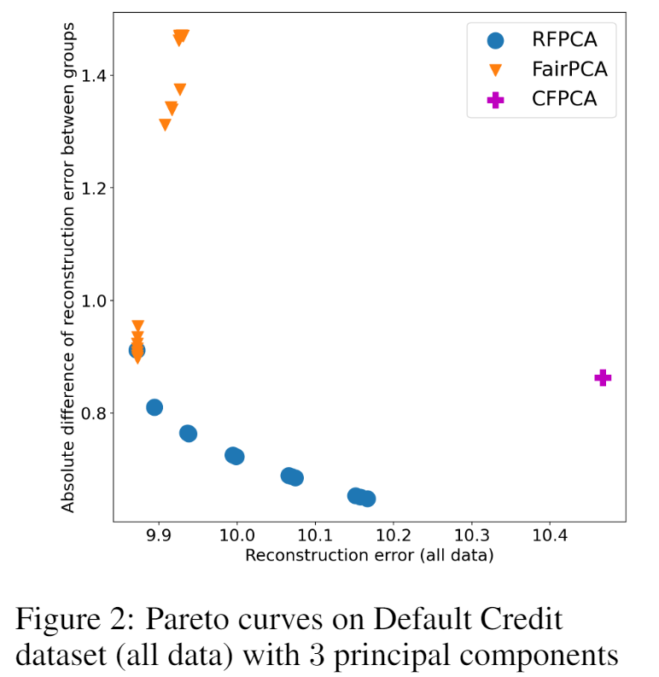
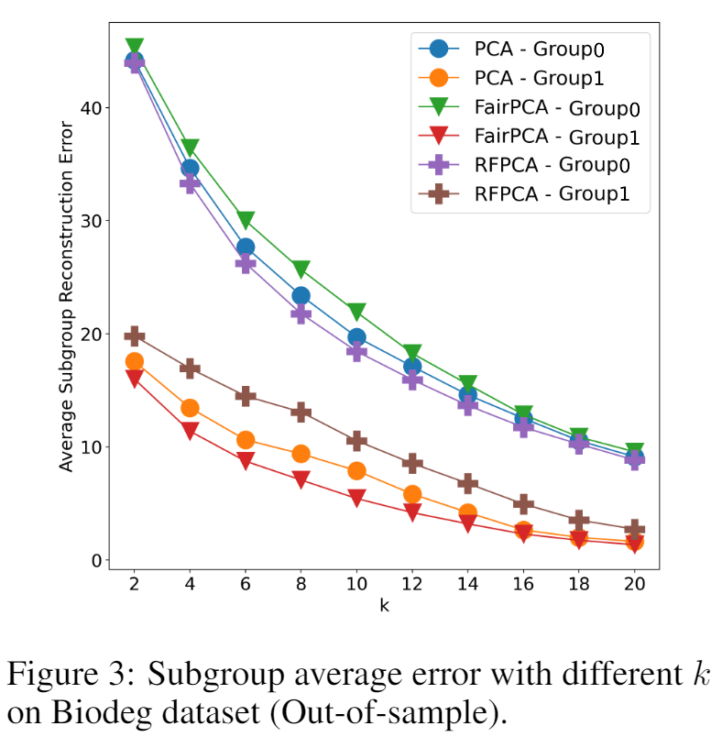
Experiment Results

Slide 8

THANK YOU
FOR
LISTENING!
Contact: vutronghieu.04012203@gmail.com
More information: hieuvt29.github.io/vu2021rfpca

